Slide 1
Introduction to Tensor
Seongbeen Lee
Sookmyung Women’s Univ.

Slide 2
Contents
Shortcuts on Jupyter
What are tensor and array?
Is it possible to change the type of the data?
Visualize your tensor!
Something useful tools for you.
From CPU to GPU and type casting.
Slicing

Slide 3
Shortcuts on Jupyter
편집 모드/ 커맨드 모드
enter/ Esc
셀 위/ 아래에 추가
a/ b
셀 삭제
dd
셀 복사/ 잘라내기/ 붙여넣기
c x v
코드 한 줄의 맨 앞/ 뒤
home / end
셀 맨 앞/ 뒤
up/ down
커널 재시작
00
커널 인터럽트
ii
주석처리
ctrl + /
ctrl/ shift/ alt

Slide 4
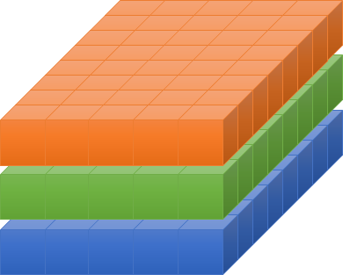
What are tensor and array?
텐서(tensor)는 배열(array)이나 행렬(matrix)과 매우 유사한 특수한 자료구조
Vector data(2D)
Time series / sequence data(3D)
Image(4D)
Video(5D)
https://tutorials.pytorch.kr/beginner/blitz/tensor_tutorial.html

Slide 5
Is it possible to change the type of the data?
Torch- Tensor
Numpy – Array
1.2 ~ 1.4
Tensor
Array
(list)
Tensor
Array
(list)

Slide 6
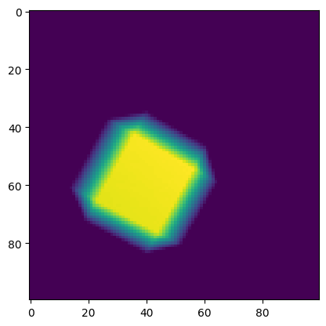
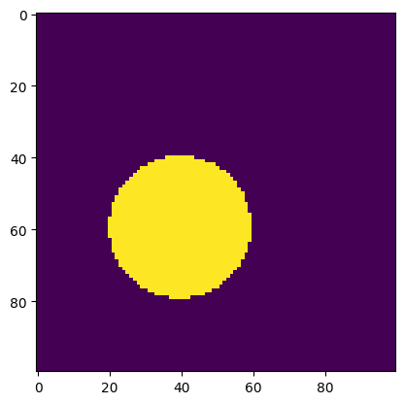
Visualize your tensor!
(a)
Histogram
Matplotlib
Plotly
(b)
(c)
Time series
Image
12
11
800K
10
600K
9
HR RMSE (bpm)
Number of parameters
400K
8
7
200K
6
0K
1
2
4
8
16
32
64
BS
Boxplot

Slide 7
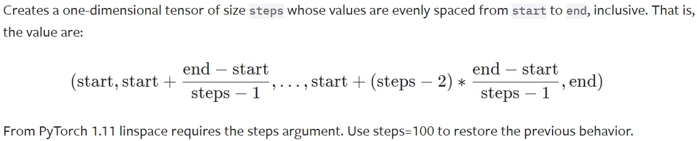
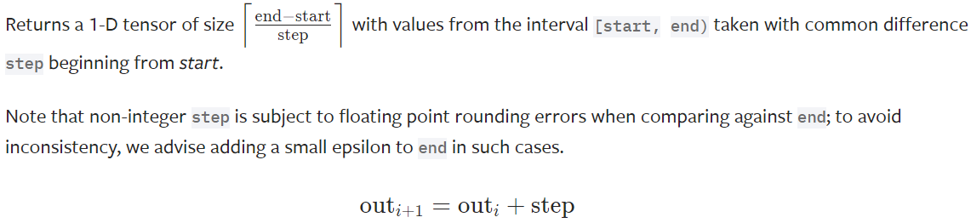
Something useful methods for you.
torch/ numpy
linspace(1.5.1)
arrange(1.5.2)
https://pytorch.org/docs/stable/generated/torch.linspace.html
https://pytorch.org/docs/stable/generated/torch.arange.html

Slide 8
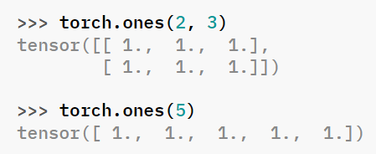
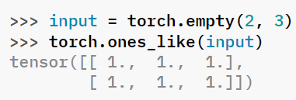
Something useful methods for you.
torch/ numpy
ones/ zeros/ empty/ full(1.5.3)
ones_like/ zeros_like / empty_like(1.5.4)
https://pytorch.org/docs/stable/generated/torch.ones.html
https://pytorch.org/docs/stable/generated/torch.ones_like.html

Slide 9
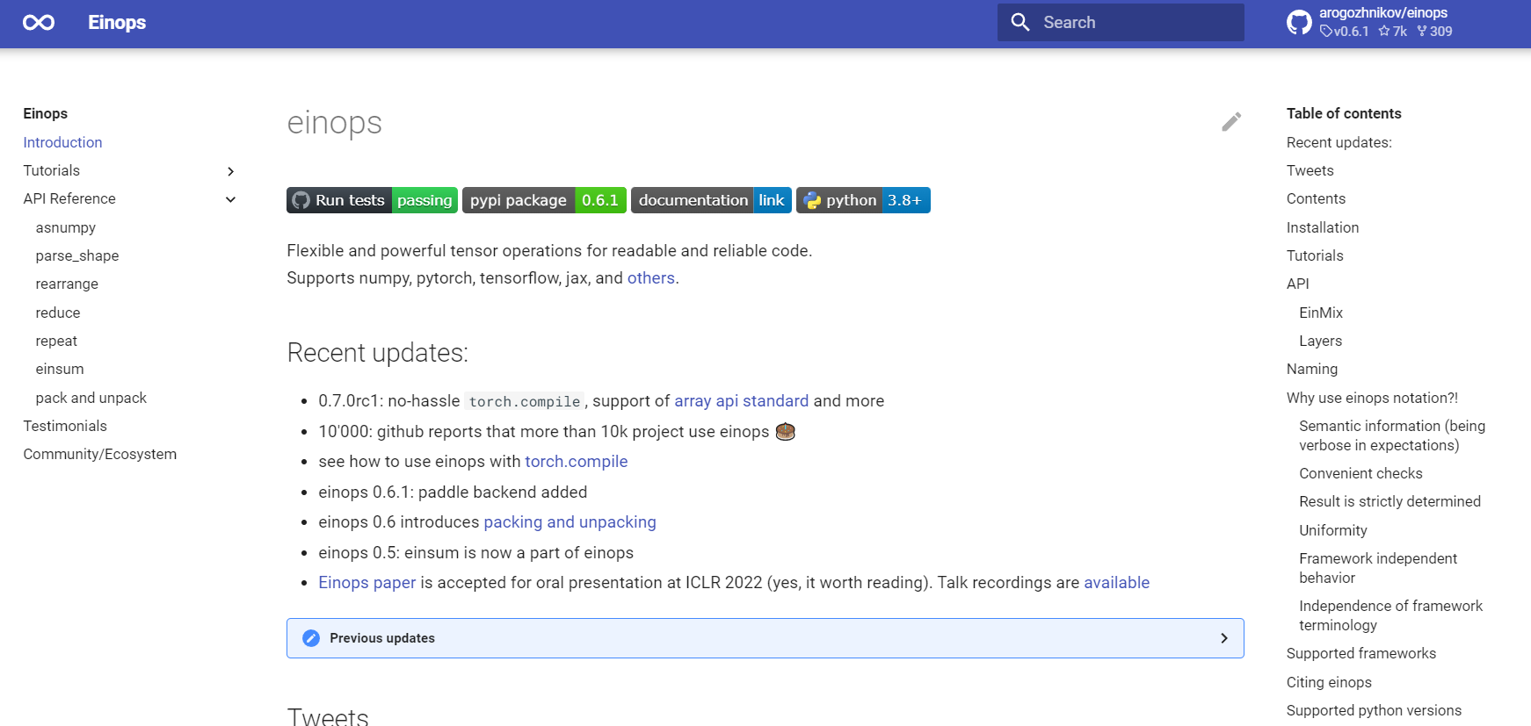
Something useful methods for you.
Einops
https://einops.rocks/

Slide 10
From CPU to GPU and type casting.
CPU ↔ GPU(1.5.5)
Tensor.to(device)
“cpu”, “gpu”
.cuda(), .cpu()
Type casting(1.5.6)
Forcing a type of variable to change to another type
Tensor.dtype()
ex) int, float, double

